Slide 1


<Name>
<Date>

Slide 2

Outline
Executive Summary
Introduction
Methodology
Results
Conclusion
Appendix

Slide 3
Executive Summary
Summary of methodologies:
Data Collection
Data Wrangling
Exploratory Data Analysis
Interactive Visual Analytics
Predictive Analysis (Classification)
Summary of all results:
Exploratory Data Analysis Result
Launch Sites Location Analysis
Interactive Dashboard
Predictive Analysis with different Classification models

Slide 4
Introduction
SpaceX advertises that a rocket named Falcon 9 can be launched at the cost of 62 million dollars on its website. This is considerably cheaper than other provider which usually cost upward of 165 million dollars each. Much of the saving is due to SpaceX is able to reuse the first stage of the rocket.
The goal of this project to determine whether the first stage of the rocket will land, therefore to estimate the cost of a launch. Such information can be useful if an alternative company wishes to bid against SpaceX for a rocket launch
Notes:
Project background and context
Problems you want to find answers

Slide 5

Section 1

Slide 6
Methodology
Executive Summary
Data collection methodology:
Describe how data was collected
Perform data wrangling
Describe how data was processed
Perform exploratory data analysis (EDA) using visualization and SQL
Perform interactive visual analytics using Folium and Plotly Dash
Perform predictive analysis using classification models
How to build, tune, evaluate classification models

Slide 7
Data Collection
Making a GET request to the SpaceX API
Web scraping from Wikipedia page
Notes:
Describe how data sets were collected.
You need to present your data collection process use key phrases and flowcharts

Slide 8
Data Collection – SpaceX API
Use SpaceX API to collect data such as rocket name, payload mass, orbit type, launch site details, and landing details
Request SpaceX launch data using GET request
Decode the response as json and convert it to a Pandas DataFrame
Use custom logic to filter unwanted launches
Use custom function and API to get information about each launch using the ID
Create a dictionary of list to store the data
Construct dataset by creating a Pandas DataFrame from the dictionary
Filter the dataframe to only include Falcon 9 launches
Reset the FlightNumber column
Replace missing value in PayLoadMass column with mean PayLoadMass value
Notes:
Present your data collection with SpaceX REST calls using key phrases and flowcharts
Add the GitHub URL of the completed SpaceX API calls notebook (must include completed code cell and outcome cell), as an external reference and peer-review purpose

Slide 9
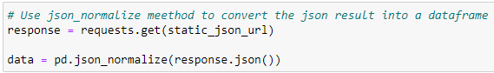
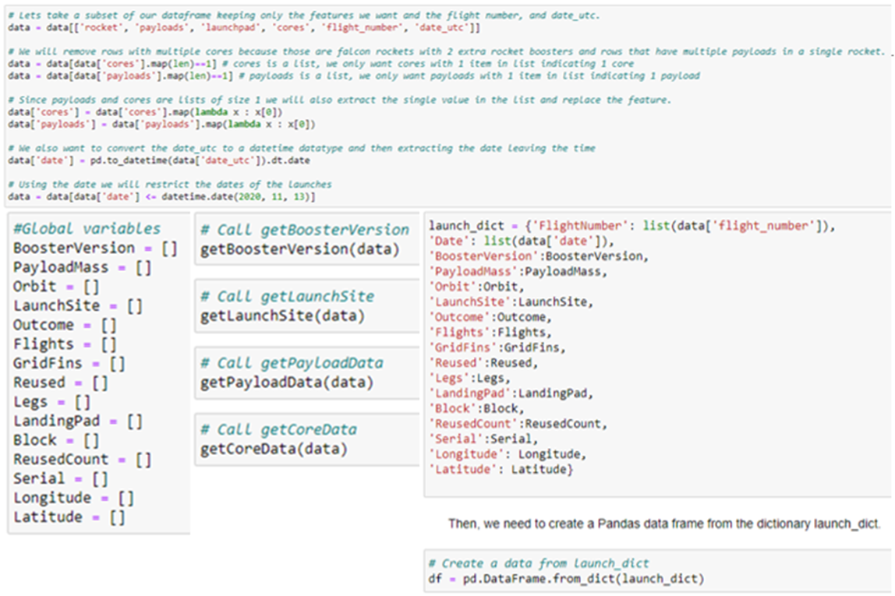
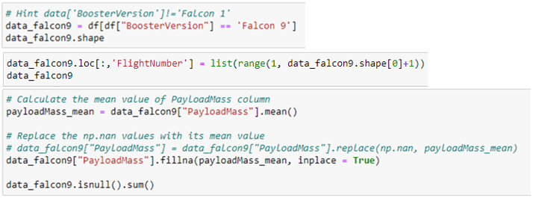
Data Collection – SpaceX API
Notes:
Present your data collection with SpaceX REST calls using key phrases and flowcharts
Add the GitHub URL of the completed SpaceX API calls notebook (must include completed code cell and outcome cell), as an external reference and peer-review purpose

Slide 10
Data Collection - Scraping
web scraping to collect Falcon 9 historical launch records from a Wikipedia page titled List of Falcon 9 and Falcon Heavy launches
Request the Falcon9 Launch Wiki page from its URL
Create BeautifulSoup object from the HTML response
Find all tables on the wiki pages
Collect all relevant column names from the HTML table header
Create empty dictionary with key as the extracted column names
Use custom logic to extract relevant data to fill in the dictionary
Convert the dictionary into a Pandas DataFrame
Notes:
Present your web scraping process using key phrases and flowcharts
Add the GitHub URL of the completed web scraping notebook, as an external reference and peer-review purpose

Slide 11
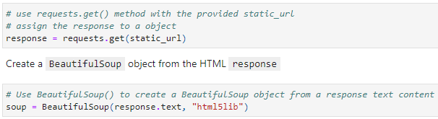
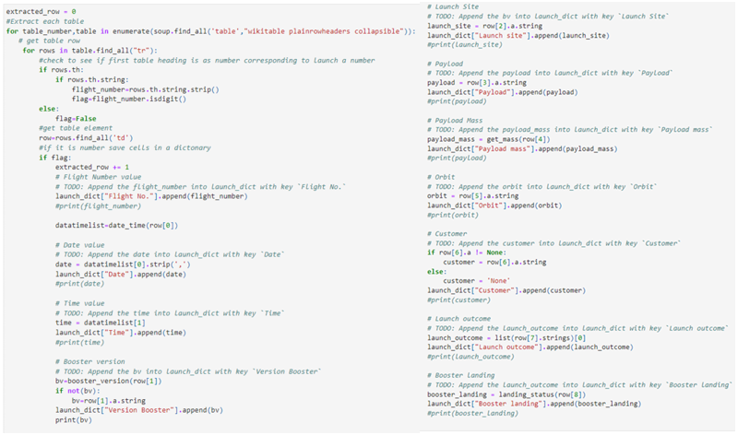
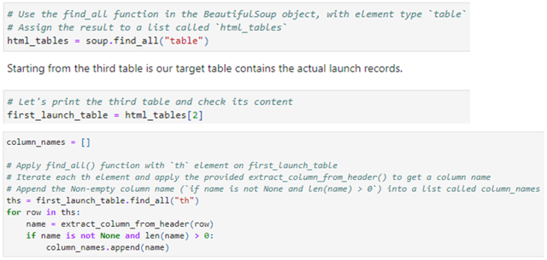
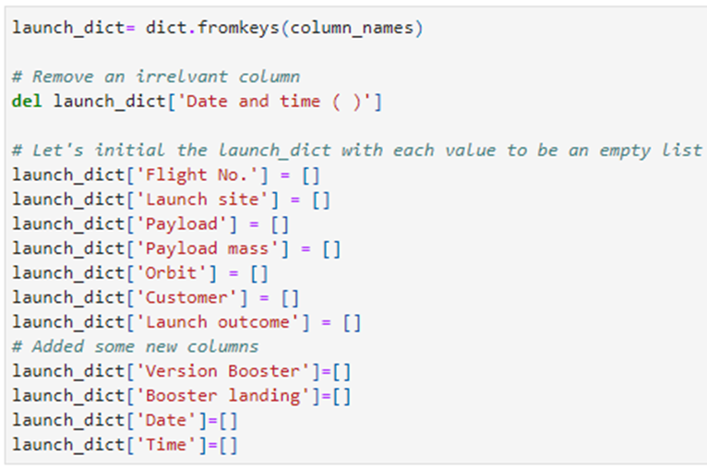
Data Collection - Scraping
Notes:
Present your web scraping process using key phrases and flowcharts
Add the GitHub URL of the completed web scraping notebook, as an external reference and peer-review purpose

Slide 12
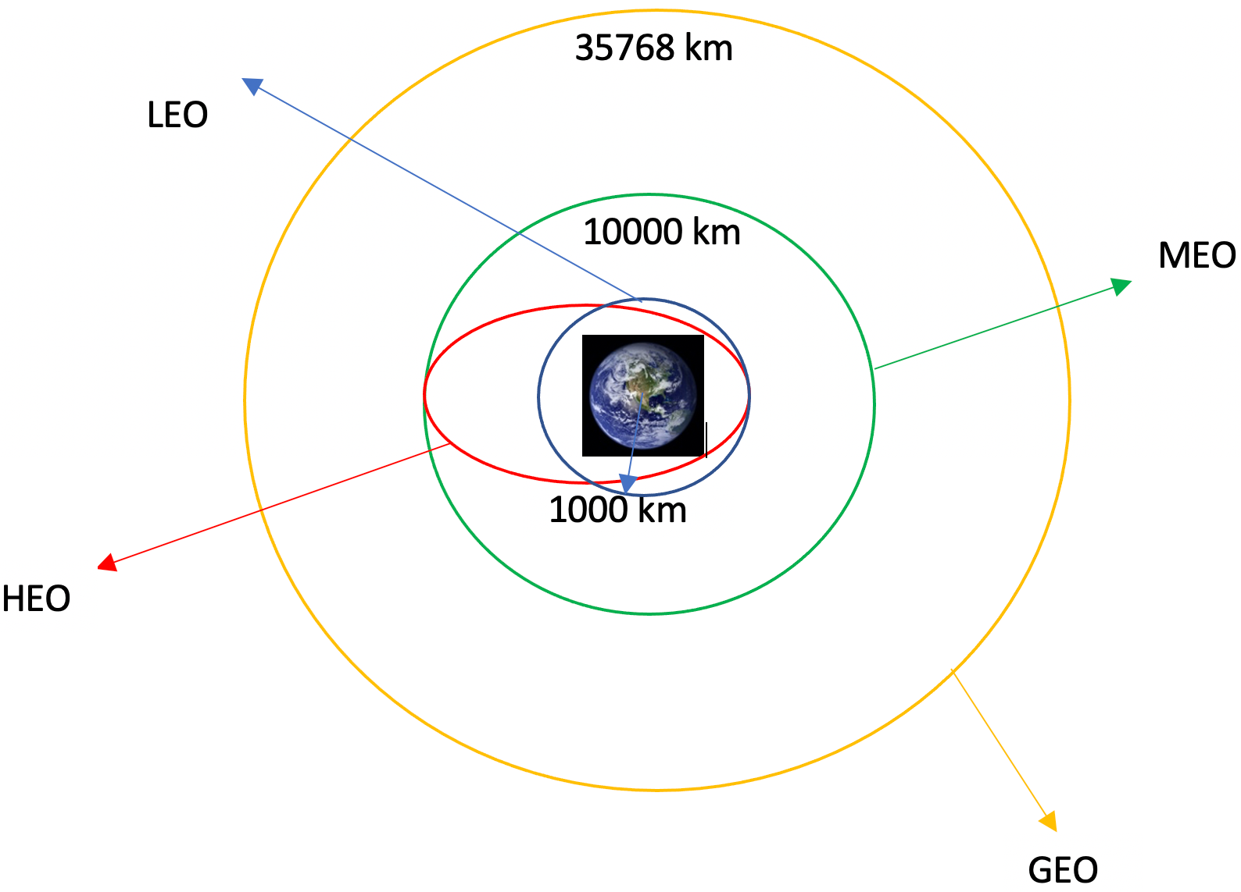
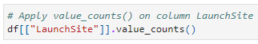
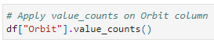
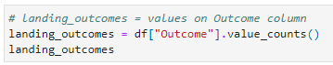
Data Wrangling
The dataset contains several SpaceX launch facilities. The location of each launch is stored in the LaunchSite column.
Each launch aims to an dedicated orbit. Some common orbit types are shown in the following plot
Use method value_count() to determine:
the number of launches on each site in LaunchSite column,
The number and occurrence of each orbit in Orbit column
The number of landing outcome in Outcome column
Notes:
Describe how data were processed
You need to present your data wrangling process using key phrases and flowcharts
Add the GitHub URL of your completed data wrangling related notebooks, as an external reference and peer-review purpose

Slide 13
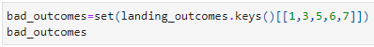
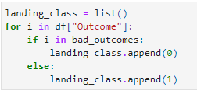
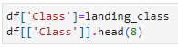
Data Wrangling
There are various values in the Outcome column:
True Ocean - the mission outcome was successfully landed to a specific region of the ocean
False Ocean - the mission outcome was unsuccessfully landed to a specific region of the ocean
True RTLS - the mission outcome was successfully landed to a ground pad
False RTLS - the mission outcome was unsuccessfully landed to a ground pad
True ASDS - the mission outcome was successfully landed to a drone ship
False ASDS - the mission outcome was unsuccessfully landed to a drone ship
None ASDS - failure to land
None None - failure to land
In order to determine whether the booster landed successfully, a binary column is created where 1 represents success and 0 represent failure:
create a set bad_outcome to store the fail outcome
Create a list where value is 0 if corresponding row in Outcome is in bad_outcome; otherwise value is 1
Assign the list to column named Class
Notes:
Describe how data were processed
You need to present your data wrangling process using key phrases and flowcharts
Add the GitHub URL of your completed data wrangling related notebooks, as an external reference and peer-review purpose

Slide 14
EDA with Data Visualization
Scatter Plot
Bar Chart
Scatter plot is used to visualize the relationship between:
Flight Number and Launch Site
Payload and Launch Site
Flight Number and Orbit Type
Payload and Orbit Type
Bar chart is used to visualize the relationship between:
Success rate of each orbit type
Scatter Plot can determine whether there is a relationship/correlation between two variables
Bar chart can show the distribution of data or compare values across different subgroup of data
Line Graph
Line graph is used to visualize:
Launch success yearly trend
Line graph can show changes over a periods of time
Notes:
Summarize what charts were plotted and why you used those charts
Add the GitHub URL of your completed EDA with data visualization notebook, as an external reference and peer-review purpose

Slide 15
EDA with SQL
SQL is used to retrieve information from the dataset
SQL queries are used to answer the following questions:
the names of the unique launch sites in the space mission
5 records where launch sites begin with the string 'CCA‘
the total payload mass carried by boosters launched by NASA (CRS)
average payload mass carried by booster version F9 v1.1
the date when the first successful landing outcome in ground pad was achieved
the names of the boosters which have success in drone ship and have payload mass greater than 4000 but less than 6000
the total number of successful and failure mission outcomes
the names of the booster_versions which have carried the maximum payload mass
the failed landing_outcomes in drone ship, their booster versions, and launch site names for in year 2015
Rank the count of landing outcomes (such as Failure (drone ship) or Success (ground pad)) between the date 2010-06-04 and 2017-03-20, in descending order
Notes:
Using bullet point format, summarize the SQL queries you performed
Add the GitHub URL of your completed EDA with SQL notebook, as an external reference and peer-review purpose

Slide 16
Build an Interactive Map with Folium
The following steps were performed to analyze the launch site locations:
Mark all launch sites on map
Create folium Map object with NASA Johnson Space Center as initial center location
Create and add folium Circle and Marker object for each launch site on the site map
Mark success and failed launches for each site on the map
Create Marker Cluster to contain multiple markers with same coordinate
Create new column in dataset named marker_color to store marker color based on the Class value
Create folium Marker for each launch and add to marker cluster
Create icon for each launch with color based on marker_color column
Calculate the distances between a launch site to its proximities
Calculate the distance between launch site and its proximity based on their Lat and Long values
Create folium Marker to show the distance
Draw a PolyLine between the points
Notes:
Summarize what map objects such as markers, circles, lines, etc. you created and added to a folium map
Explain why you added those objects
Add the GitHub URL of your completed interactive map with Folium map, as an external reference and peer-review purpose

Slide 17
Build a Dashboard with Plotly Dash
The following plots were added to dashboard to create an interactive visualization of the data
Pie chart showing the total successful launches per site
This shows which sites have the most successful launches
This chart can be filtered to show success/failure rate for each launch site
Scatter graph to show the relationship between outcome and payload mass (kg)
This graph can be filtered by range of the payload mass
It can also be filtered by booster version
Notes:
Summarize what plots/graphs and interactions you have added to a dashboard
Explain why you added those plots and interactions
Add the GitHub URL of your completed Plotly Dash lab, as an external reference and peer-review purpose

Slide 18
Predictive Analysis (Classification)
The following steps are taken to build, evaluate and find the best performing classification model:
Model Development:
Prepare Dataset for model development
Load dataset
Create Numpy array from Class column in dataset as Y
Standardize data X
Split data X and Y into training and test set using train_test_split(). 20% of the data is used as test set
Model development
Create GridSearchCV object for each algorithm with cv = 10
Create dictionary of parameters for grid search
Fit training set into the model
Model Evaluation:
For each model:
Use best_params_ to show the best parameters
Use best_score_ to show the accuracy of the model
Use score to calculate the accuracy on test data
Plot the confusion matrix
Choose Best Classification Model
Compare the accuracy score across all models
Model with highest accuracy score is select as the best classification model
Notes:
Summarize how you built, evaluated, improved, and found the best performing classification model
You need present your model development process using key phrases and flowchart
Add the GitHub URL of your completed predictive analysis lab, as an external reference and peer-review purpose

Slide 19
Results
Exploratory data analysis results
Interactive analytics demo in screenshots
Predictive analysis results

Slide 20

Section 2

Slide 21
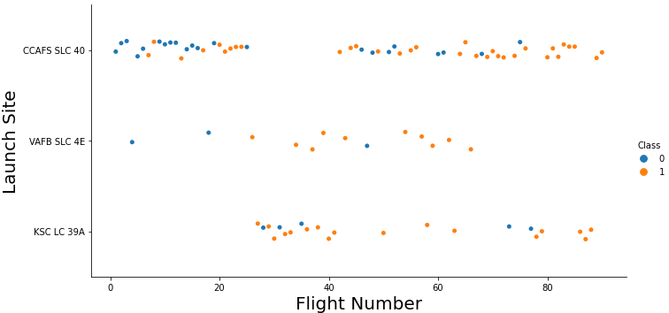
Flight Number vs. Launch Site
As the Flight Number increase, the rate of success also increase
There is a improvement in success rate with Flight Number > 30
Most of the early launches (< 30) were in CCAFS SLC 40 and were mostly failed
Both CCAFS SLC 40 and VAFB SLC 4E shows that early launch tends to fail
KSC LC 39A does not shows the trend because its Flight Number is higher (> 30)
Notes:
Show a scatter plot of Flight Number vs. Launch Site
Show the screenshot of the scatter plot with explanations

Slide 22
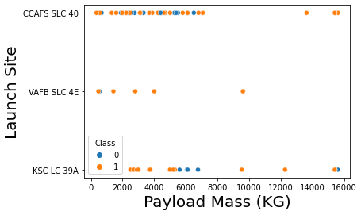
Payload vs. Launch Site
Payload Mass greater than 7000KG has a higher success rate
KSC LC 39A have all success landing with Payload Mass less than 5500KG
CCAFS SLC 40 have the most launches with Payload Mass less than 8000KG
The is no clear relationship between Payload Mass and success rate in each launch site
Notes:
Show a scatter plot of Payload vs. Launch Site
Show the screenshot of the scatter plot with explanations

Slide 23
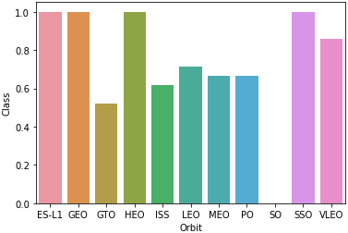
Success Rate vs. Orbit Type
The following Orbit type have 100% success rate:
ES-L1
GEO
HEO
SSO
Only SO Orbit type have 0% success rate
Notes:
Show a bar chart for the success rate of each orbit type
Show the screenshot of the scatter plot with explanations

Slide 24
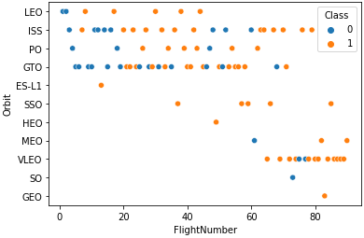
Flight Number vs. Orbit Type
Most launches focus on LEO, ISS, PO and GTO Orbit types
VLEO have more launches when Flight Number is greater than 60
100% success rate of GEO, HEO, and ES-L1 can be explained by only having 1 launches
Notes:
Show a scatter point of Flight number vs. Orbit type
Show the screenshot of the scatter plot with explanations

Slide 25
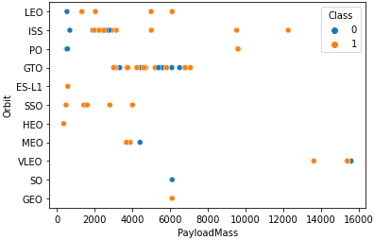
Payload vs. Orbit Type
Orbit types with 100% success rate are all with Payload Mass less than 7000KG
Payload Mass to GTO Orbit type are between 3000KG to 8000KG, however the relationship between success rate and Payload Mass is unclear
ISS and PO Orbit have 100% success rate with high Payload Mass (> 10000KG), but there is limited data points
Notes:
Show a scatter point of payload vs. orbit type
Show the screenshot of the scatter plot with explanations

Slide 26
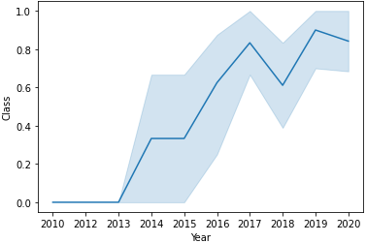
Launch Success Yearly Trend
All the landing between 2010 and 2013 were unsuccessful
There is a significant improvement after 2013
Although there is fluctuation, the success rate does not drop below 50% since it is achieved after 2015
Notes:
Show a line chart of yearly average success rate
Show the screenshot of the scatter plot with explanations

Slide 27
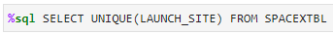
All Launch Site Names
Find the names of the unique launch sites
The UNIQUE keyword only return unique value from LAUNCH_SITE column of SPACEXTBL table
Notes:
Find the names of the unique launch sites
Present your query result with a short explanation here

Slide 28
Launch Site Names Begin with 'CCA'
Find 5 records where launch sites begin with `CCA`
The LIKE keyword is used with the wild card ‘CCA%’ to retrieve string value begin with ‘CCA’
The LIMIT 5 keyword only fetch 5 records from the table
Notes:
Find 5 records where launch sites begin with `CCA`
Present your query result with a short explanation here

Slide 29
Total Payload Mass
Calculate the total payload carried by boosters from NASA
The SUM keyword is used to sum up the return value from PAYLOAD_MASS_KG where the Customer is NASA (CRS)
Notes:
Calculate the total payload carried by boosters from NASA
Present your query result with a short explanation here

Slide 30
Average Payload Mass by F9 v1.1
Calculate the average payload mass carried by booster version F9 v1.1
The AVG keyword is used to calculate the average of returned value from PAYLOAD_MASS_KG where the booster version is F9 v1.1
Notes:
Calculate the average payload mass carried by booster version F9 v1.1
Present your query result with a short explanation here

Slide 31
First Successful Ground Landing Date
Find the dates of the first successful landing outcome on ground pad
The MIN keyword is used to find the minimum returned value from DATE where the landing outcome is success in ground pad
Notes:
Find the dates of the first successful landing outcome on ground pad
Present your query result with a short explanation here

Slide 32
Successful Drone Ship Landing with Payload between 4000 and 6000
List the names of boosters which have successfully landed on drone ship and had payload mass greater than 4000 but less than 6000
Return the booster version where the landing outcome is success in drone ship and the payload mass is between 4000 and 6000
The BETWEEN keyword filter value between 4000 and 6000
Notes:
List the names of boosters which have successfully landed on drone ship and had payload mass greater than 4000 but less than 6000
Present your query result with a short explanation here

Slide 33
Total Number of Successful and Failure Mission Outcomes
Calculate the total number of successful and failure mission outcomes
The COUNT keyword is used to calculate the number of mission outcome
The GROUP BY keyword is used to group result by the mission outcome
Notes:
Calculate the total number of successful and failure mission outcomes
Present your query result with a short explanation here

Slide 34
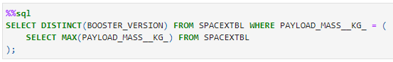
Boosters Carried Maximum Payload
List the names of the booster which have carried the maximum payload mass
The subquery is used to retrieve the maximum Payload mass from the table
The DISTINCT keyword is used retrieve unique booster version where its payload mass is the maximum value
Notes:
List the names of the booster which have carried the maximum payload mass
Present your query result with a short explanation here

Slide 35
2015 Launch Records
List the failed landing_outcomes in drone ship, their booster versions, and launch site names for in year 2015
The WHERE clause is used to filter result with failure in drone ship
The EXTRACT keyword is used to extract the year from the DATE column
Notes:
List the failed landing_outcomes in drone ship, their booster versions, and launch site names for in year 2015
Present your query result with a short explanation here

Slide 36
Rank Landing Outcomes Between 2010-06-04 and 2017-03-20
Rank the count of landing outcomes (such as Failure (drone ship) or Success (ground pad)) between the date 2010-06-04 and 2017-03-20, in descending order
The COUNT keyword is used to calculate the numbers of landing outcome
The BETWEEN keyword is used to filter the date between 2010-06-04 and 2017-03-20
The GROUP BY keyword is used to group the result by landing outcome
The ORDER BY keyword is used to order the results based on the numbers of landing outcome
Notes:
Rank the count of landing outcomes (such as Failure (drone ship) or Success (ground pad)) between the date 2010-06-04 and 2017-03-20, in descending order
Present your query result with a short explanation here

Slide 37

Section 3

Slide 38
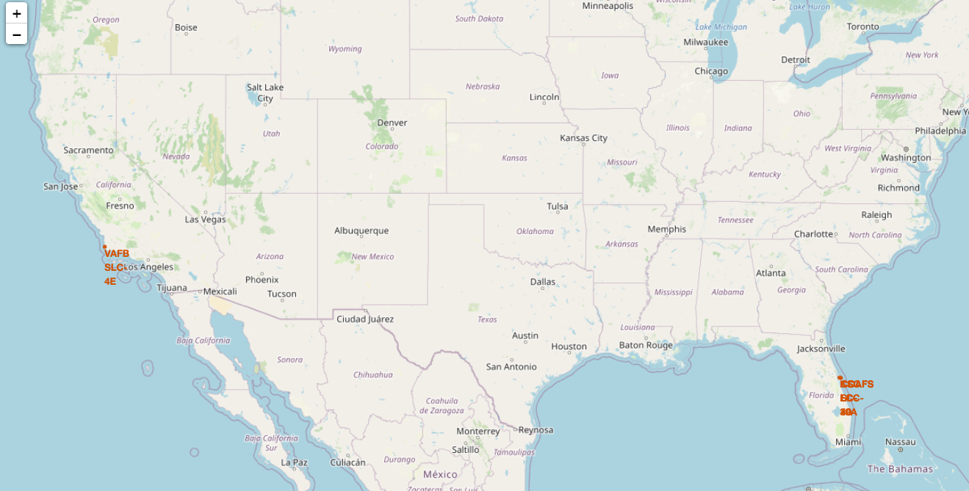
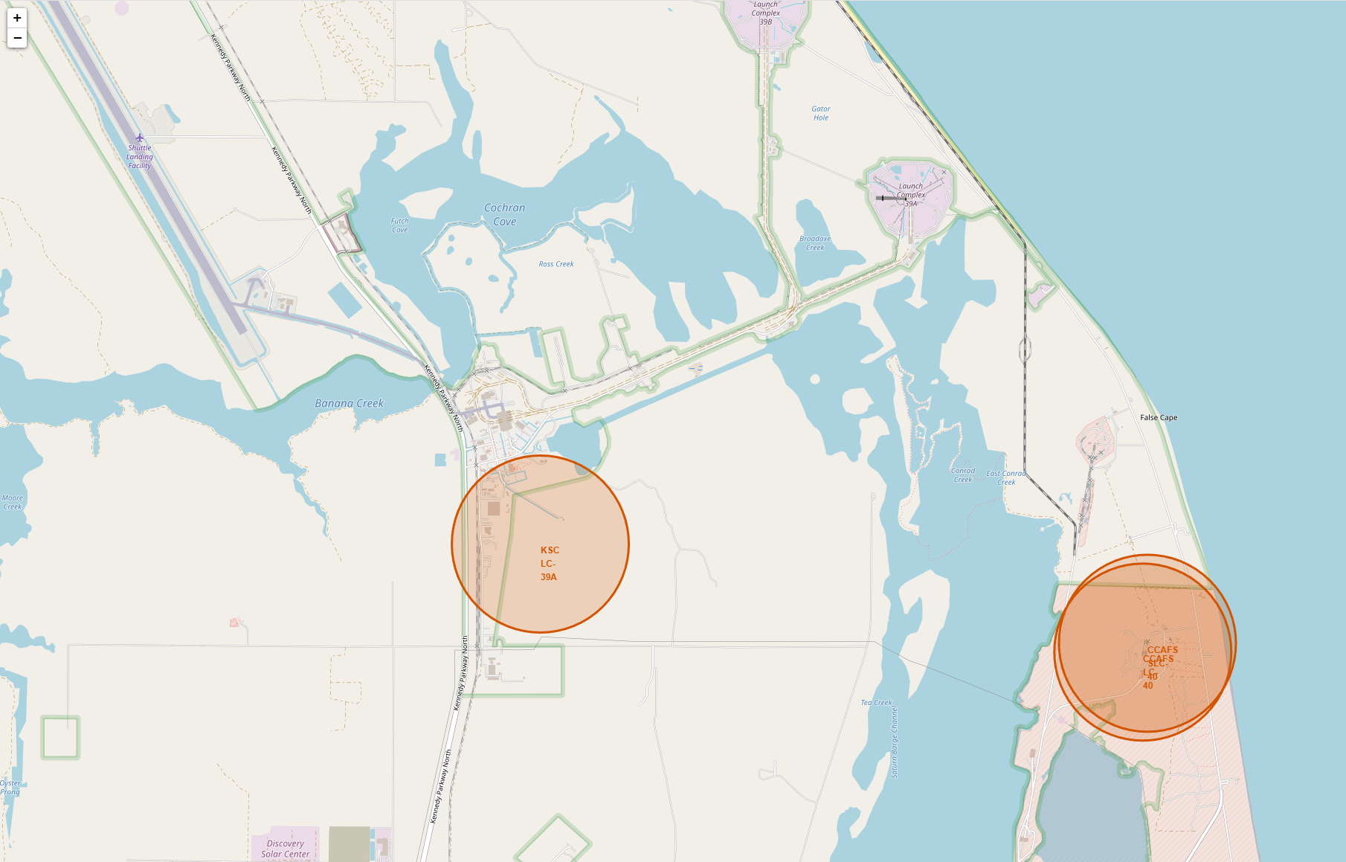
All launch sites on a map
There are 3 Launch sites in Florida
There is only 1 Launch sites in California
All Launch sites are close to the coasts of US
Notes:
Replace <Folium map screenshot 1> title with an appropriate title
Explore the generated folium map and make a proper screenshot to include all launch sites’ location markers on a global map
Explain the important elements and findings on the screenshot

Slide 39
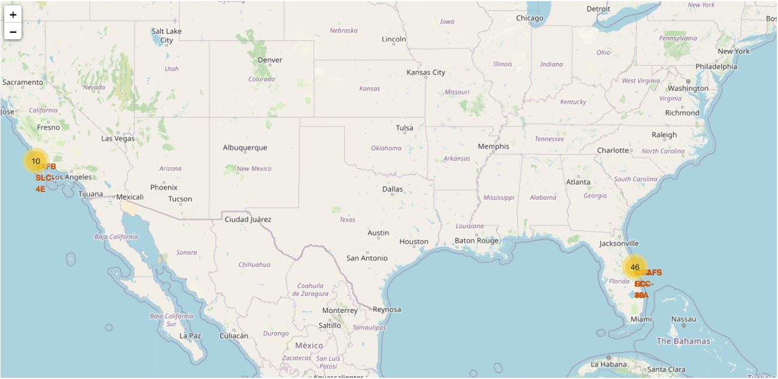
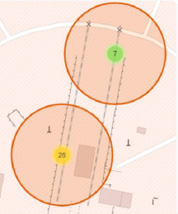
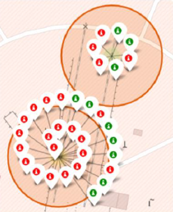
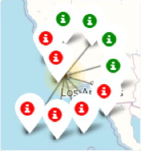
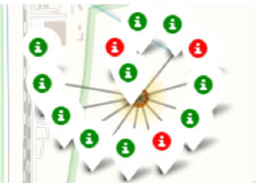
Success/failed launched for each sites
All launches are grouped into cluster and annotated with green if success and red if failed
CCAFS SLC-40 & CCAFS LC-40
VAFB SLC-4E
KSC LC-39A
Notes:
Replace <Folium map screenshot 2> title with an appropriate title
Explore the folium map and make a proper screenshot to show the color-labeled launch outcomes on the map
Explain the important elements and findings on the screenshot

Slide 40
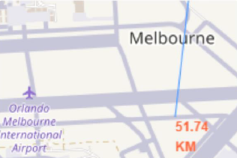
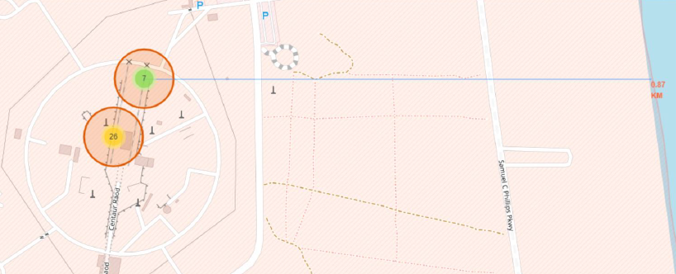
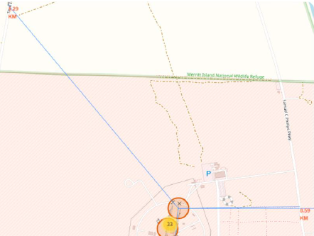
Proximity of Launch Sites to other point of interest
With CCAFS SLC-40 launch sire as example:
Are launch sites in close proximity to railways?
Yes, The railways is only 1.29kn away
Are launch sites in close proximity to highways?
Yes, The highway is only 0.59km away
Are launch sites in close proximity to coastline?
Yes, The coastline is only 0.87km away
Do launch sites keep certain distance away from cities?
Yes, Melbourne city is 51.74km away
Notes:
Replace <Folium map screenshot 3> title with an appropriate title
Explore the generated folium map and show the screenshot of a selected launch site to its proximities such as railway, highway, coastline, with distance calculated and displayed
Explain the important elements and findings on the screenshot

Slide 41

Section 4

Slide 42
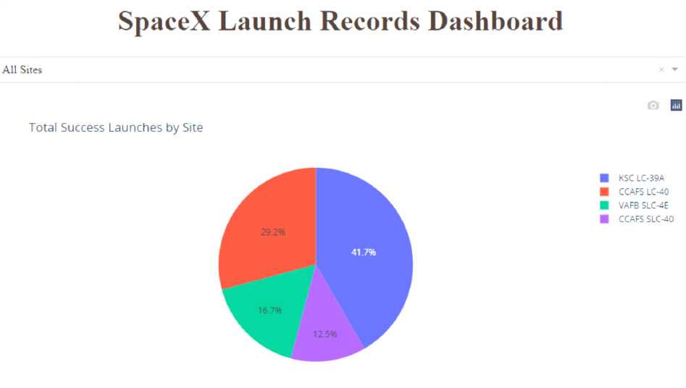
Launch Success count for all sites
The launch site KSC LC-39A have the highest success launches with 41.7% of the total success launch
Notes:
Replace <Dashboard screenshot 1> title with an appropriate title
Show the screenshot of launch success count for all sites, in a piechart
Explain the important elements and findings on the screenshot

Slide 43
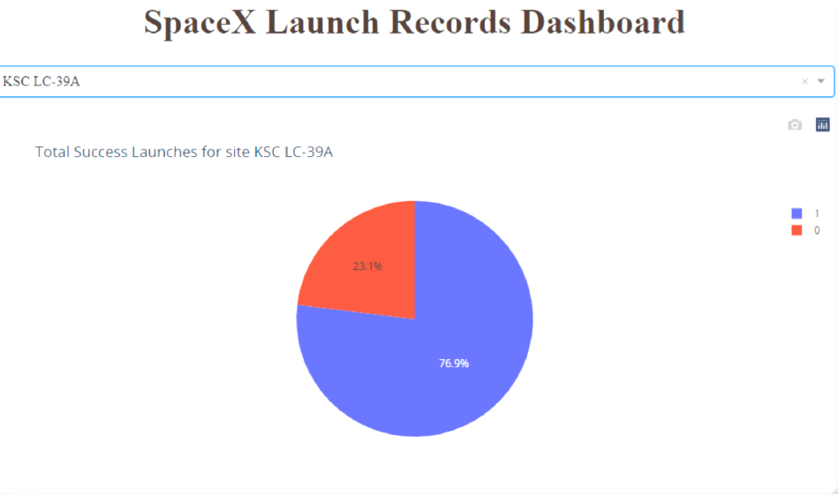
Launch Site with highest launch success ratio
The launch site KSC LC-39A has the highest launch success ratio with 76.9% success rate
Notes:
Replace <Dashboard screenshot 2> title with an appropriate title
Show the screenshot of the piechart for the launch site with highest launch success ratio
Explain the important elements and findings on the screenshot

Slide 44
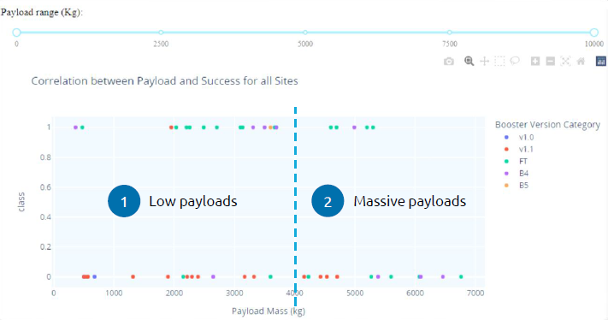
Payload vs Launch Outcome scatter ploy for all sites
The success launches of Massive payloads is lower than the launched with low payloads
Booster Version v1.0 and B5 have not been launch with massive payloads
Notes:
Replace <Dashboard screenshot 3> title with an appropriate title
Show screenshots of Payload vs. Launch Outcome scatter plot for all sites, with different payload selected in the range slider
Explain the important elements and findings on the screenshot, such as which payload range or booster version have the largest success rate, etc.

Slide 45

Section 5

Slide 46
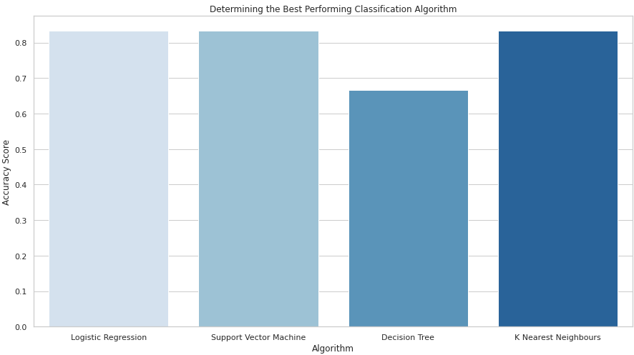
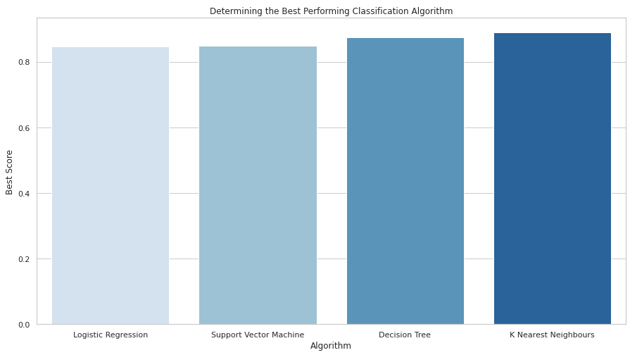
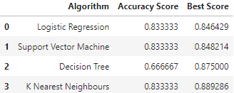
Classification Accuracy
By building different classification models:
K Nearest Neighbours model has the highest classification accuracy
The Accuracy Score is 83.33%
The Best Score is 88.92%
Notes:
Visualize the built model accuracy for all built classification models, in a bar chart
Find which model has the highest classification accuracy

Slide 47
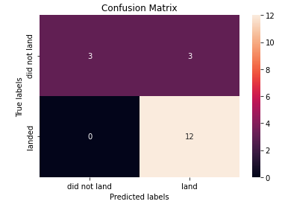
Confusion Matrix
The K Nearest Neighbours model is able to classify 15 out of 18 correct results
The other 3 results that are classified incorrectly is in the false positive
Notes:
Show the confusion matrix of the best performing model with an explanation

Slide 48
Conclusions
As the Flight Number increase, the rate of success also increase:
All the landing between 2010 and 2013 were unsuccessful
There is a significant improvement after 2013
Although there is fluctuation, the success rate does not drop below 50% since it is achieved after 2015
Orbit type ES-L1, GEO, HEO, SSO have 100% success rate:
100% success rate of GEO, HEO, and ES-L1 can be explained by only having 1 launches
Orbit types with 100% success rate are all with Payload Mass less than 7000KG
Most launches focus on LEO, ISS, PO and GTO Orbit types
ISS and PO Orbit have 100% success rate with high Payload Mass (> 10000KG), but there is limited data points
The launch site KSC LC-39A have the highest success launches with 41.7% of the total success launch and highest launch success ratio with 76.9% success rate
The success launches of Massive payloads (> 4000KG) is lower than the launched with low payloads
The best performing model is K Nearest Neighbours with Best Score of 88.92%

Slide 49
Appendix
Include any relevant assets like Python code snippets, SQL queries, charts, Notebook outputs, or data sets that you may have created during this project

Slide 50


